Slide 1
Basics of Programming Language

Slide 2
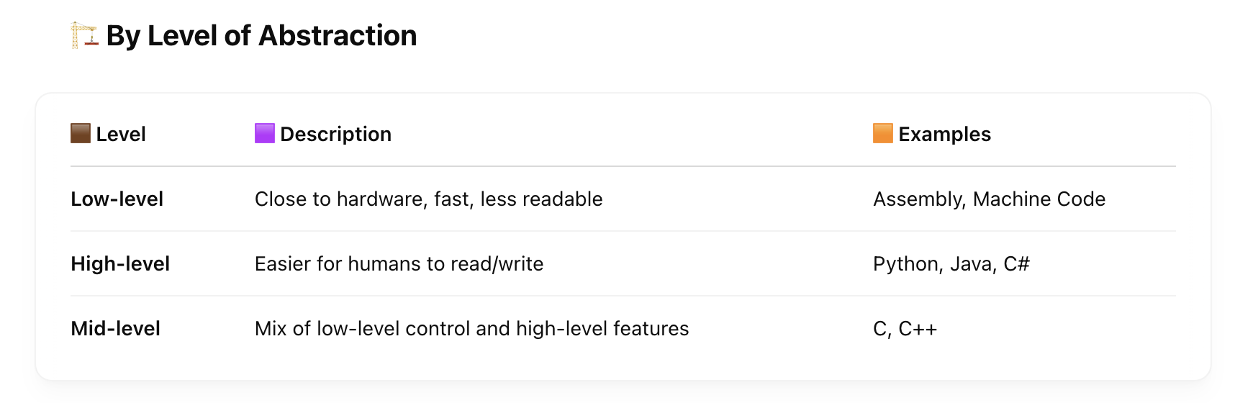
Programming Languages

Slide 3
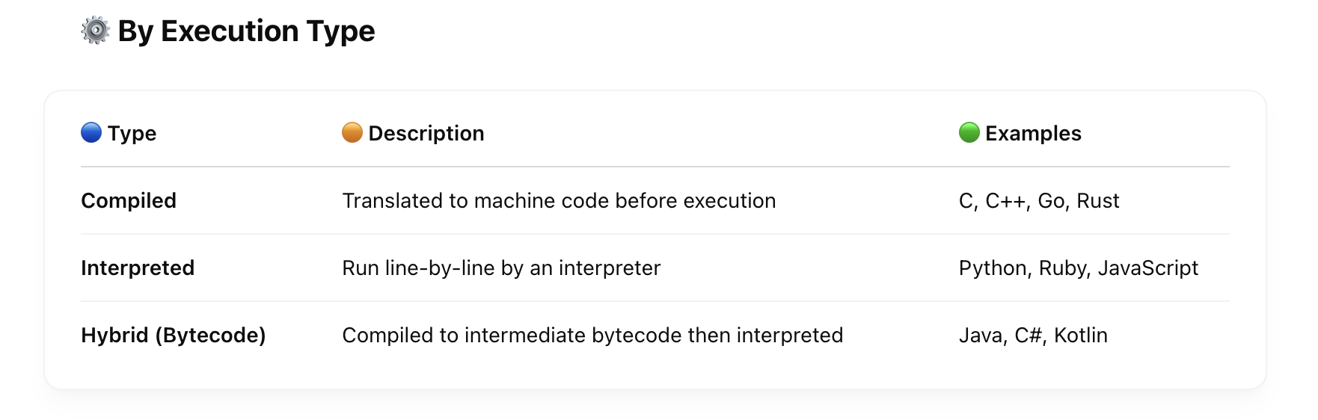

Slide 4
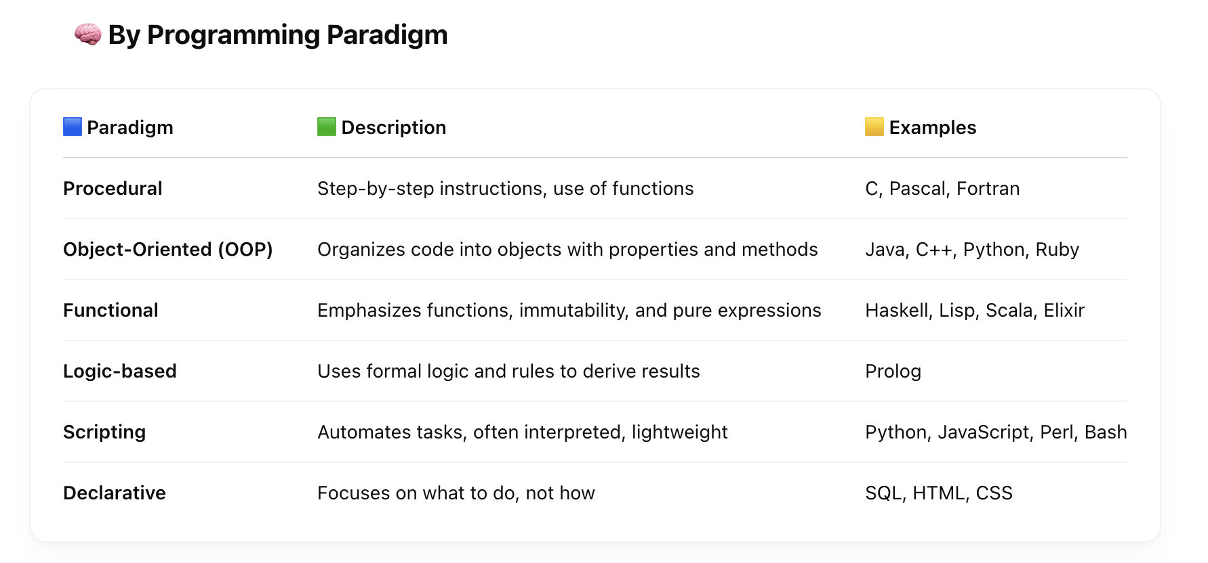

Slide 5
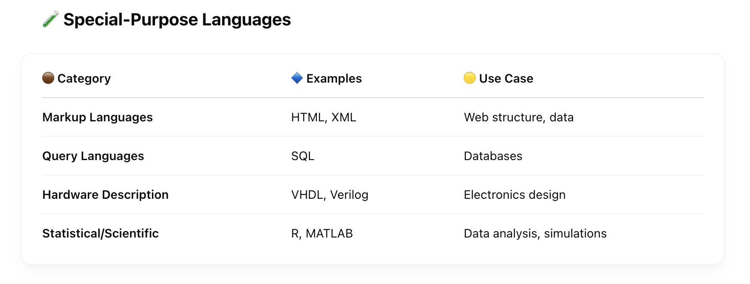

Slide 6
Object Oriented Programming
A pure object-oriented language is a programming language in which everything is treated as an object. This includes primitive types (like integers, characters, booleans), functions/methods, and even control structures in some cases. The core principles are:
Key Traits of Pure Object-Oriented Languages:
Everything is an object.
All operations are performed by sending messages to objects.
All values are objects (including numbers, functions, etc.).
Classes and inheritance are central concepts.
Polymorphism and encapsulation are consistently applied.

Slide 7
Not Pure Object-Oriented:
Java: Primitive types (like int, boolean) are not objects.
C++: Mixes procedural and object-oriented programming.
Python: Very object-oriented, but not purely — e.g., functions can exist outside of classes.
Smalltalk is considered as pure OOP
Smalltalk | Considered the "gold standard" of pure OOP. Everything (even numbers and control flow) is an object.
Ruby | Very close to pure OOP. Even literals like 5 are objects (5.class returns Integer).
Scala | Highly object-oriented but mixes with functional programming. Some debate about purity.

Slide 8
Java Ecosystem
The Java ecosystem consists of three core components:
🔹 𝗝𝗗𝗞 (𝗝𝗮𝘃𝗮 𝗗𝗲𝘃𝗲𝗹𝗼𝗽𝗺𝗲𝗻𝘁 𝗞𝗶𝘁) - The complete toolkit for developers, containing the JRE plus compilers, debuggers, and development tools.
🔹 𝗝𝗥𝗘 (𝗝𝗮𝘃𝗮 𝗥𝘂𝗻𝘁𝗶𝗺𝗲 𝗘𝗻𝘃𝗶𝗿𝗼𝗻𝗺𝗲𝗻𝘁) - Contains the JVM plus all libraries needed to run Java applications. This is what end users need installed.
🔹 𝗝𝗩𝗠 (𝗝𝗮𝘃𝗮 𝗩𝗶𝗿𝘁𝘂𝗮𝗹 𝗠𝗮𝗰𝗵𝗶𝗻𝗲) - The engine that executes Java bytecode, acting like a "virtual computer" that brings the same execution environment to any device. This is what enables the famous "Write Once, Run Anywhere" philosophy.
The relationship between them is hierarchical:
The JDK contains the JRE
The JRE contains the JVM
Therefore: JDK → JRE → JVM

Slide 9
Java Virtual Machine
Main JVM Components
Class Loader: Loads class files into memory;
Method Area: Stores method definitions and static code;
Heap: Manages memory for object allocation;
Stack: Stores local variables and partial results;
Execution Engine: Executes the instructions;
Garbage Collector: Automatic memory management, eliminating what has already been used in the program.

Slide 10
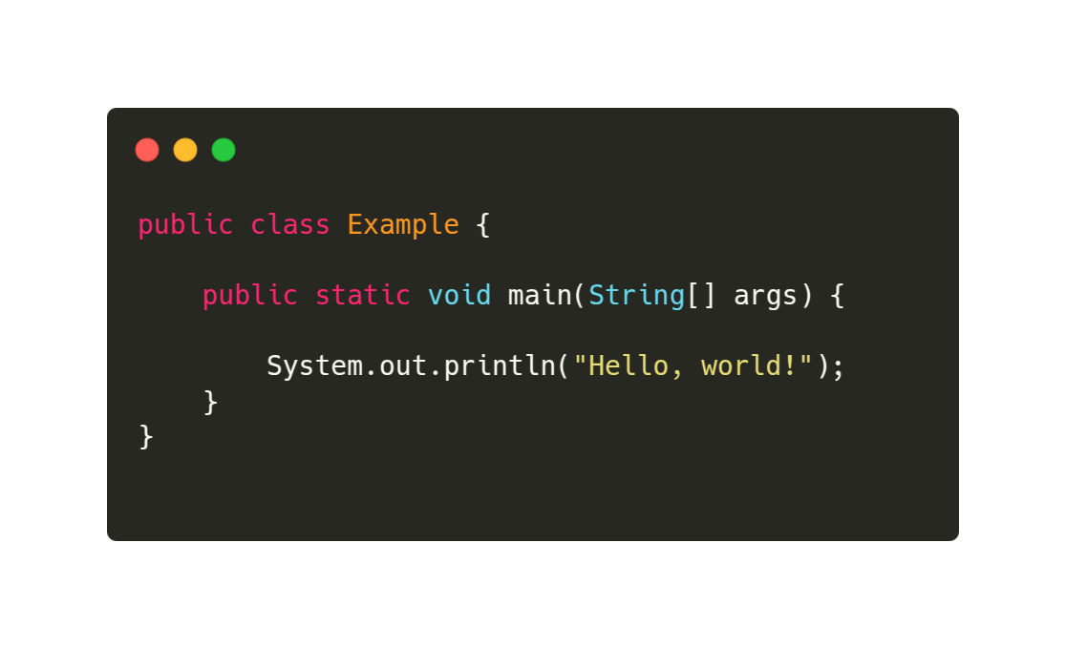

Slide 11
Before Java 11:
📘 Compiling and executing with the JDK
$ javac Example.java // Uses the JDK compiler to generate Example.class
$ java Example // Uses the JRE (contained in the JDK) to execute
After Java 11:
Since Java 11, you can run Java programs directly from the source file without compiling manually first.
$ java Example.java

